Slide 1



SIMATS ENGINEERING
SAVEETHA INSTITUTE OF MEDICAL AND TECHNICAL SCIENCES
Real-Time Operating System (RTOS)
In traffic signal control
CSA0411 OPERATING SYSTEM
Guided by:
Dr.Ria sudheen .H
Presented by:
Saipriya S (192365065)

Slide 2



Introduction to Traffic Signal Control
  A traffic signal control system manages traffic lights at road intersections to ensure the
safe and smooth movement of vehicles and pedestrians.
Role of the Operating System:
  Controls the timing and sequence of traffic lights.
  Receives information from traffic sensors.
  Manages tasks and communication with hardware.
  Helps the system respond to traffic conditions.
Example
  Traffic lights change from green to yellow and then red according to programmed timings.

Slide 3
Type of OS Used and Justification
Real-Time Operating System (RTOS)
  An RTOS is an operating system designed to complete tasks within specified time limits.
Why is it suitable for traffic signal control
  Quick Response: Responds to sensor inputs within required time limits.
  Task Scheduling: Manages tasks according to their priority.
  Predictability: Supports timely execution of important tasks.
  Reliability: Helps maintain consistent system operation.
Example:
  When a pedestrian presses a crossing button, the controller registers the request and schedules
the crossing phase according to its rules.
Notes:
3

Slide 4
OS Structure and Components
  An RTOS coordinates the hardware and software required to control traffic signals.
Main Components:
  Hardware: Traffic lights, sensors, and pedestrian buttons.
  Device Drivers: Help the OS communicate with hardware.
  Kernel: Manages tasks and system resources.
  Task Scheduler: Decides which task runs and when.
  Application Software: Controls traffic light sequences.
working structure
Sensors → Device Drivers → RTOS Kernel → Traffic Control Application → Traffic Lights
Notes:
4

Slide 5
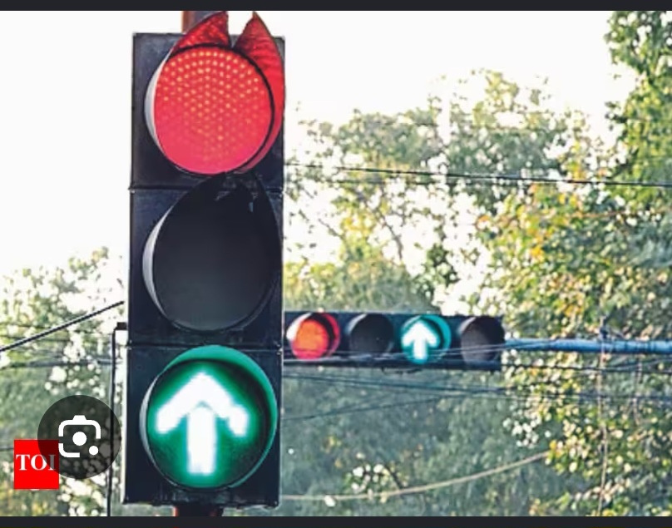
System Calls for Timing
Accurate timing helps traffic signals change at thecorrect
time and respond to road conditions.
Important TimingServices:
  Timer Services: Measure the duration of traffic light phases.
  Delay Functions: Pause tasks for a specified time.
  Periodic Scheduling: Runs tasks at regular intervals.
  Interrupt Handling: Helps respond to hardware events.
  Clock Services: Provide timing information to the system.
Example of Traffic Signal
🟢 Green Light — 30seconds
🟡 Yellow Light — 5 seconds
🔴 Red Light — 35 seconds
Notes:
6

Slide 6
Conclusion
  An RTOS helps traffic signals operate with accurate timing and quick responses.
It improves traffic management, reduces congestion, and promotes road safety.
  By coordinating sensors, traffic lights, and control tasks, the system helps reduce traffic congestion and improve road safety

Slide 7
THANK YOU

